Slide 1
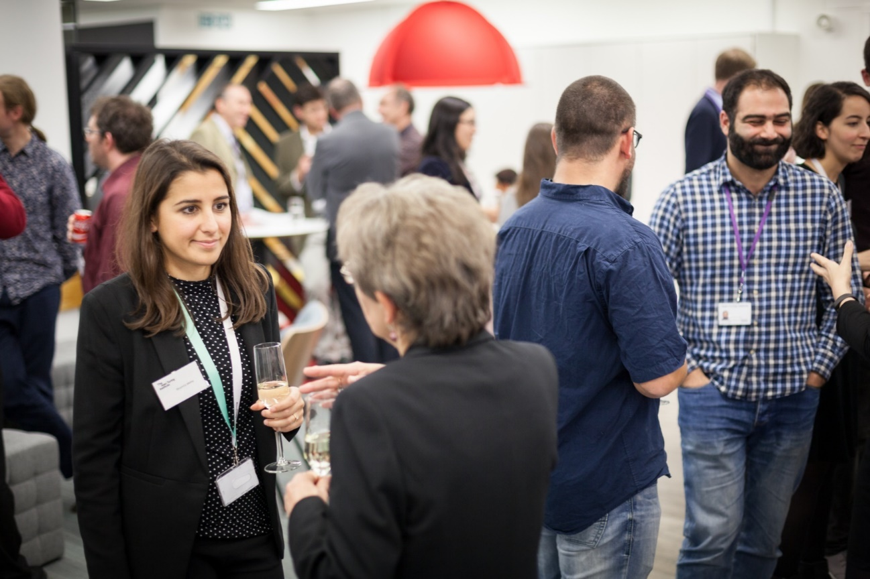
The Alan Turing Institute Data Study Group 8 December 2019
Notes:
Welcome
Ethos of the DSG
Collaboration
Values
multidisciplinary approach
Setting the ground rules
What we want to achieve

Slide 2
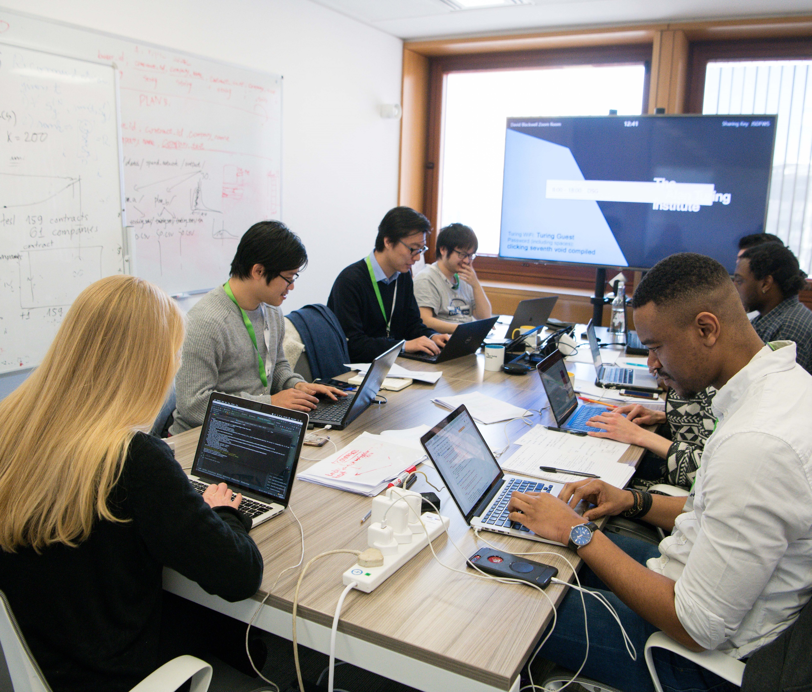
Thank you Participants!!

Slide 3
Laboratories
A&E
Fitness
Physics
Strategic Consulting
Electronics
Pharmaceuticals
Archives
Cyber Security
Transport Management
Networks
Finance
Cabinet Office
Telecoms
Local Councils
Cancer Research
Conservation
Defence & Security
Satellite
NGO
Research Institutes

Slide 4
DSG – Post- Event Questionnaire
Please please please complete our event feedback questionnaire.
(We’ll email you a link later)
The only way you can register interest in follow on projects is to complete our event feedback questionnaire
Once you have completed the feedback questionnaire you will be directed to a separate follow-on work questionnaire where you can declare your interest in further projects with the challenge owners.
IMPORTANT: in post-event questionnaire, check “agree to receive updates”

Slide 5

DSG – next steps: reports
You’re getting a (grey literature) publication out of this!
Data science PI from challenge team to lead finalization process
Wait for communication from DSG team & challenge team
next 6 weeks: tidying, cleaning of write-up (no new analyses)
Much appreciated if you’re available to answer questions on your analyses
Before you leave: Make sure all important files are saved as outputs
Tables/figures: make sure these have a complete legend or row/col headers
Attach a full caption/description (txt file) of what the tables figure show
In safe haven: put figures & hackMD file in correct output folder for egress (R:)
IMPORTANT: in post-event questionnaire, check “agree to receive updates”

Slide 6

DSG – next steps: follow-on projects
1. just continue working with challenge team
Please acknowledge DSG on publications arising in Nature/Science or elsewhere
(UKRI, etc, precise formulation in follow-on e-mail by Turing team)
2. follow-on funding opportunities (submitted by challenge team)
Turing seed funding, Turing strategic programme & event funding calls
UKRI, ISCF etc – happy to provide support letter (PoC: Catherine L)
3. align with relevant strategic programmes or work streams at Turing
Get in touch with Turing partnerships development (via Jules M or Sebastian V)
Help make sure report is nice & tidy to show to decision makers ☺
IMPORTANT: in post-event questionnaire, check “agree to receive updates”

Slide 7

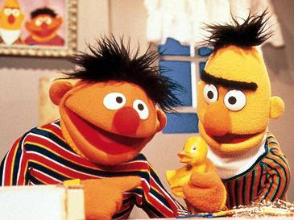
Next Turing DSG: April 20-24
we need YOU
to join the DSG as
Participant (recruitment opens Feb)
Challenge data scientist PI
(postdoc & above)
Available challenges
disseminated in
Turing bulletin
or please contact
directly
datastudygroup@turing.ac.uk
for available challenges, role descriptions and T&C

Slide 8

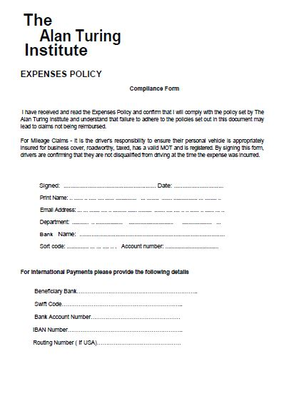
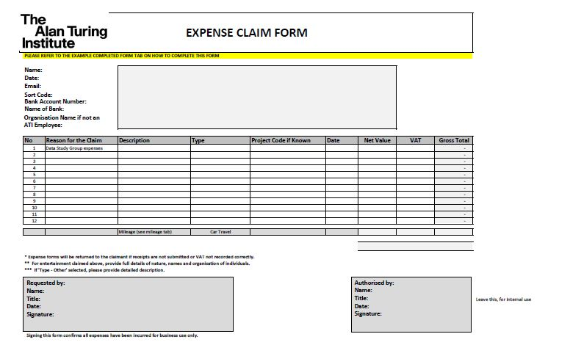
Claiming Expenses
+ All Receipts

Slide 9
Expenses
To claim expenses for travelling to the social please put ‘Social Travel’ on your expenses form
WE KNOW WHO WALKED ;)

Slide 10
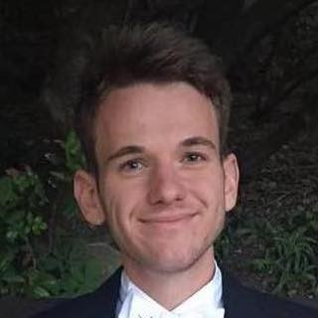
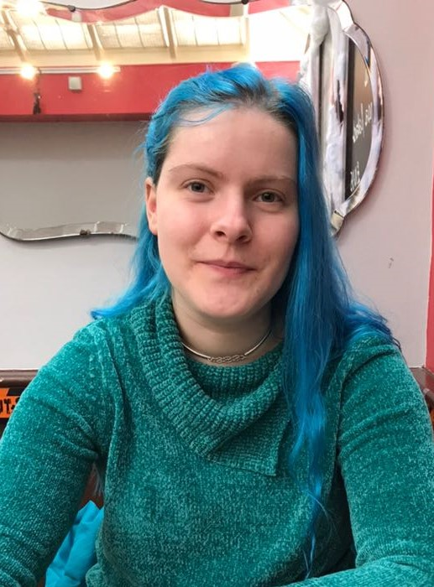
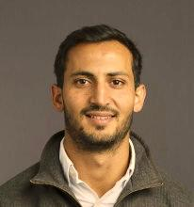
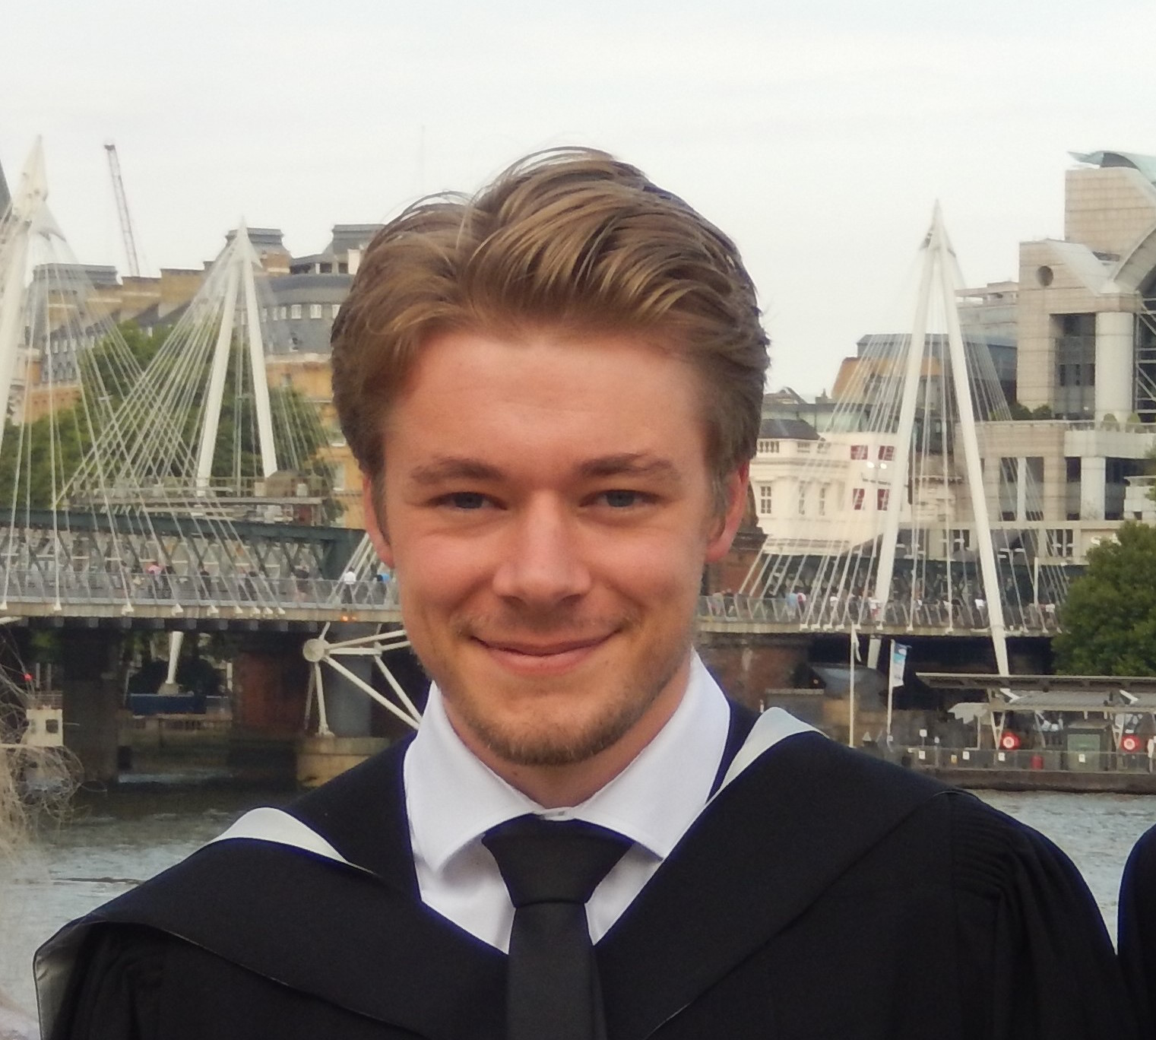
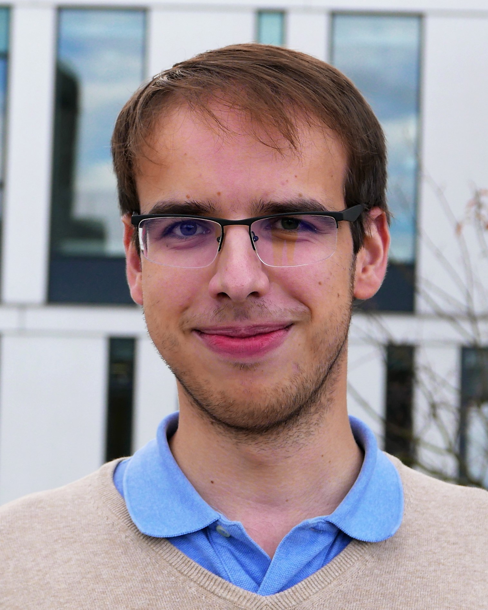
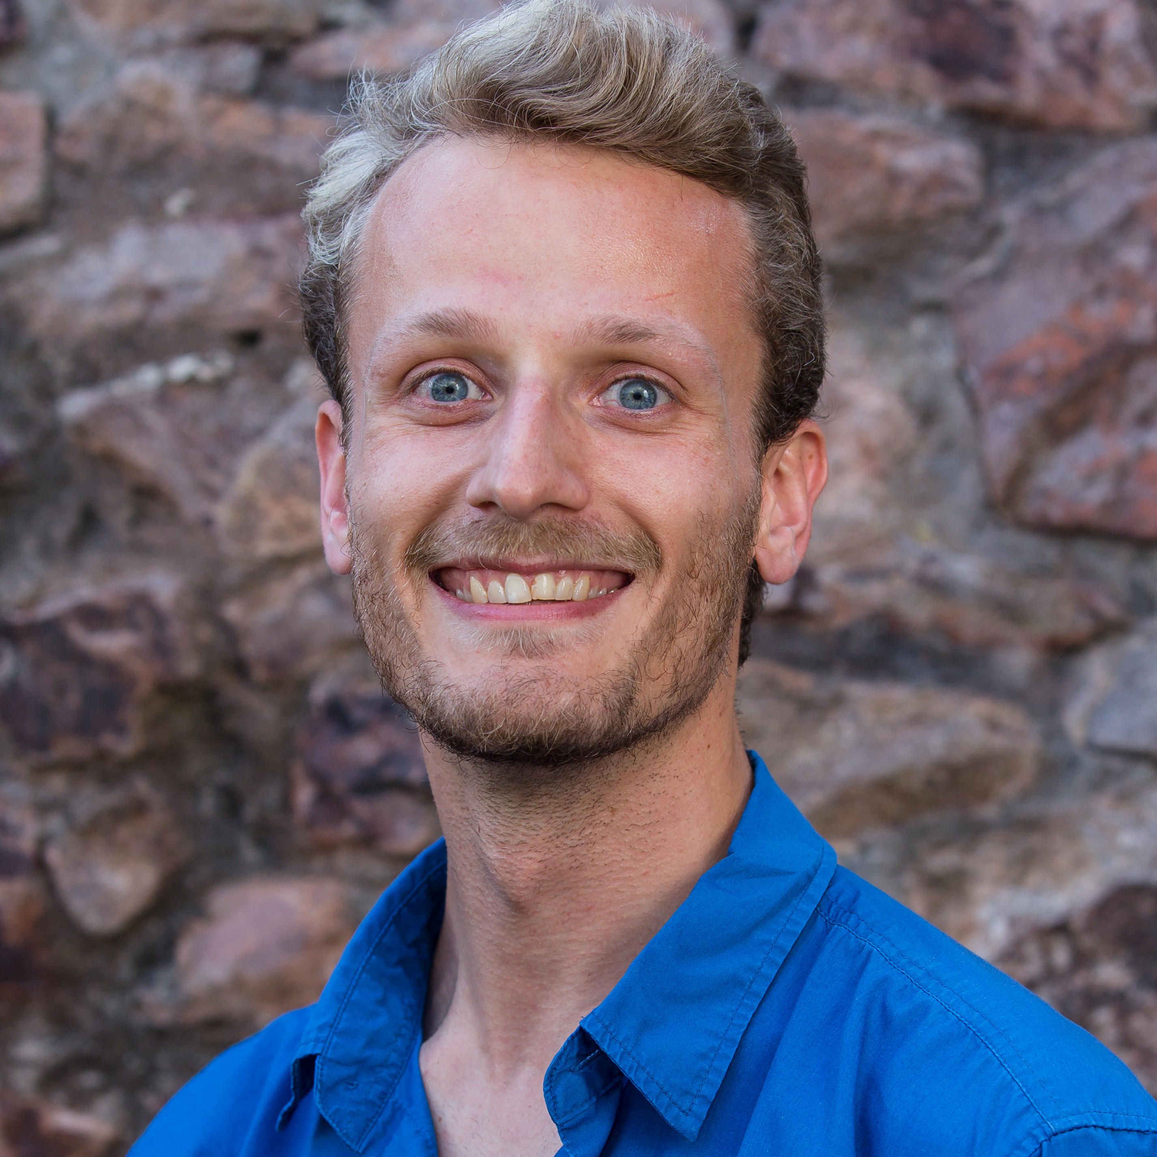
A huge thank you to your Facilitators
Adriaan Hilbers
Agile Datum
Laura Merritt
Dstl – Anthrax
Fazl Barez
The National Archives
Sam Blakeman
Dstl – Bright-field image segmentation
Ondrej Bohdal SenSat
Daniel Nielsen
WWF

Slide 11
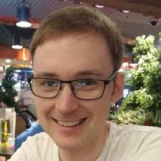
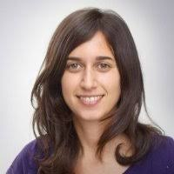
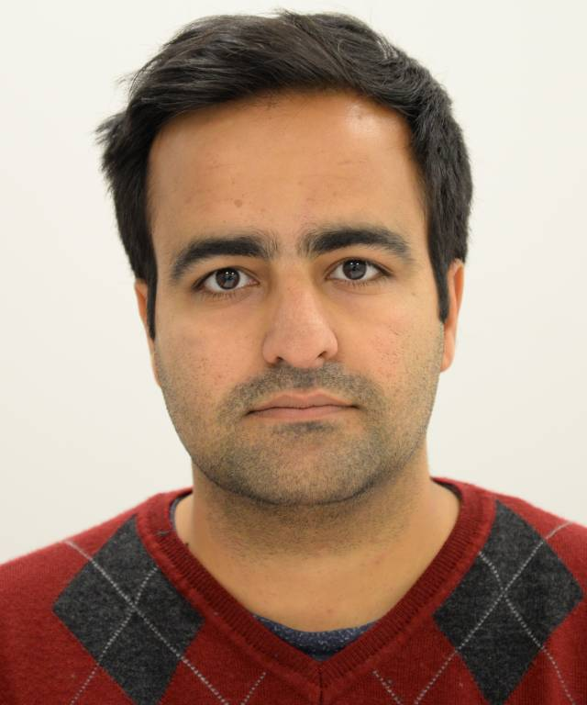
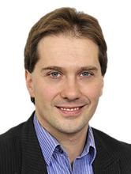
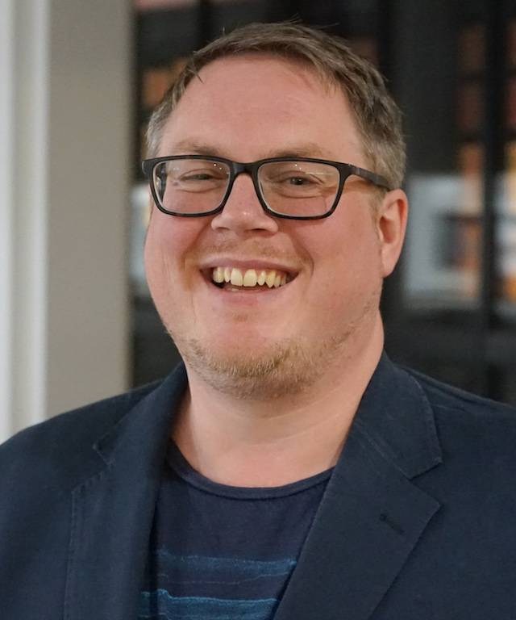
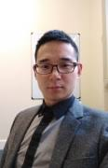
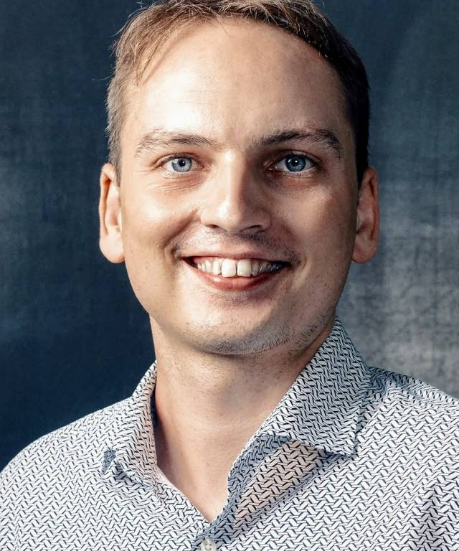
And a huge thank you to your challenge PIs!

Slide 12
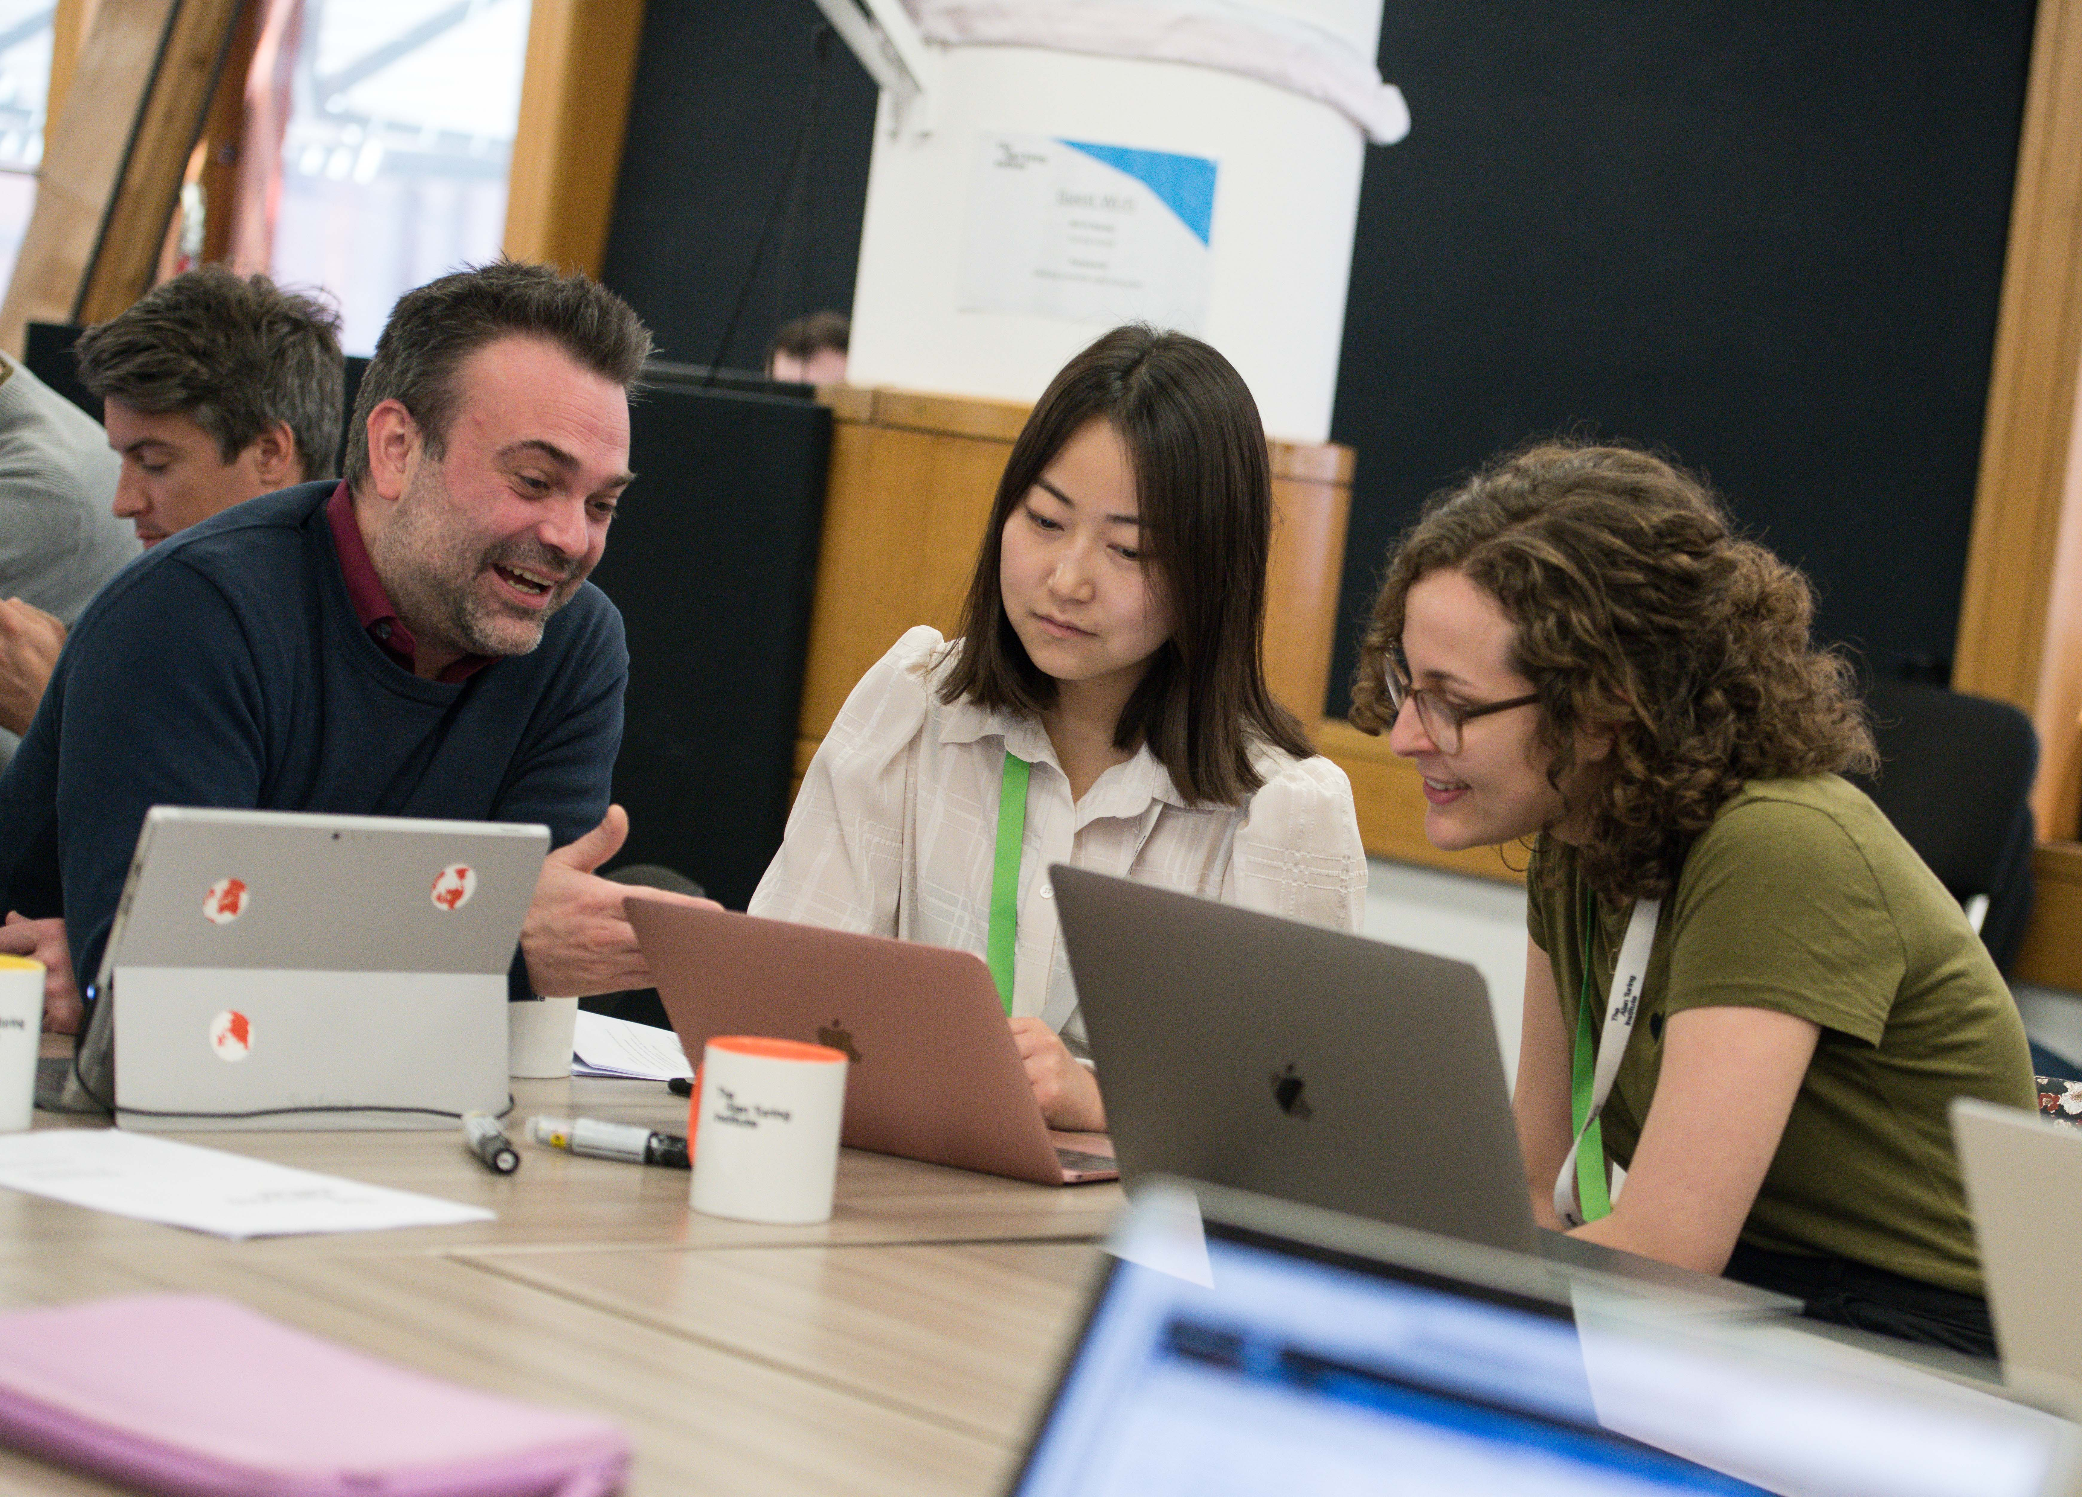
20th – 24th April 2020
SAVE THE DATE
Applications will open soon

Slide 13


Thanks for your participation, see you soon!
Also, please don’t forget to put all important files in the “output” folder
and remember to tick “agree to receive updates” in the post-event survey
Also also, There will be some filming going on during/after lunch so please get involved and let us know if you do not wish to be filmed

